Slide 1


UNIVERSITY INSTITUTEOF ENGINEERING
Bachelor of Engineering (Computer Science & Engineering)
Operating System (CST-328)
Subject Coordinator: Er. Puneet kaur(E6913)
Introduction to Operating System
DISCOVER . LEARN . EMPOWER
Font size 24

Slide 2
Lecture 1 Introduction to the Operating System

Slide 3
Why do we need an OS?
Allows you to hide details of hardware by creating an abstraction
Easy to use with a GUI
Offers an environment in which a user may execute programs/applications
The operating system must make sure that the computer system convenient to use
Operating System acts as an intermediary among applications and the hardware components
It provides the computer system resources with easy to use format
Acts as an intermediate between all hardware's and software's of the system

Slide 4
Computer System Components
Hardware – provides basic computing resources (CPU, Memory, I/O devices, Communication).
Operating System – controls and coordinates use of the hardware among various application programs for various users.
System & Application Programs – ways in which the system resources are used to solve computing problems of the users (Word processors, Compilers, Web browsers, Database systems, Video games).
Users – (People, Machines, other computers).

Slide 5
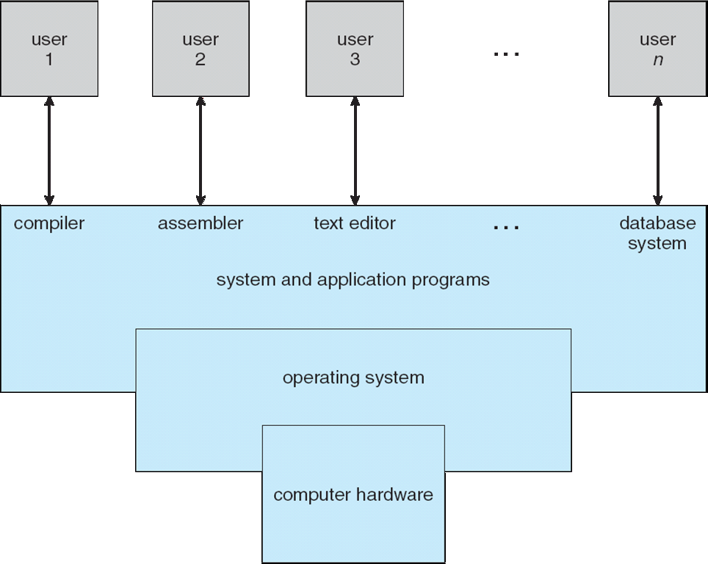
Static View of System Components

Slide 6
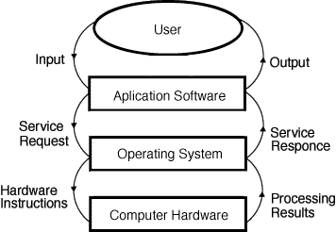
Dynamic View of System Components

Slide 7
Types of Operating System
Batch Operating System: This type of operating system does not interact with the computer directly. There is an operator which takes similar jobs having the same requirements and groups them into batches.
Time-sharing operating System: This type of operating system allows many users to share computer resources. (Max utilization of the resources).
Distributed operating System: This type of operating system manages a group of different computers and makes appear to be a single computer.
Network operating system: This type of operating system running on a server and provides the capability to manage data, users, groups, security, applications, and other networking functions.
Real-time operating system: This type of operating system serves real time system and the time interval required to process and respond to inputs is very small.

Slide 8
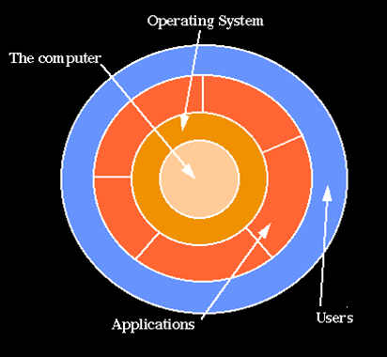
Hierarchical view of computer system

Slide 9
What is OS?
Operating System is a software, which makes a computer to actually work.
It is the software the enables all the programs we use.
The OS organizes and controls the hardware.
OS acts as an interface between the application
programs and the machine hardware.
Examples: Windows, Linux, Unix and Mac OS, etc.
Operating system goals:
Execute user programs and make user problems easier
Make the computer system convenient to use
Use the computer hardware in an efficient manner

Slide 10
Responsibilities of an Operating System
There are three basic responsibilities (in literature):
Resource Manager – manages and allocates resources.
Control program – controls the execution of user programs and operations of I/O devices.
Command Executer – Provides an environment for running user commands.
But one more modern view: the Operating System as a Virtual Machine.

Slide 11
Operating-System Structure
General-purpose OS is very large program
Various ways to structure ones
Simple structure – MS-DOS
More complex -- UNIX
Layered – an abstraction
Microkernel -Mach

Slide 12
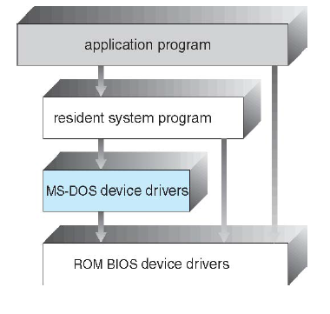
Simple Structure -- MS-DOS
MS-DOS – written to provide the most functionality in the least space Not divided into modules
Limited in H/W functionality
Although MS-DOS has some structure, its interfaces and levels of functionality are not well separated

Slide 13
Non Simple Structure -- UNIX
UNIX – limited by hardware functionality, the original UNIX operating system had limited structuring.
The UNIX OS consists of two separable parts
Systems programs
The kernel Consists of everything below the system-call interface and above the physical hardware
Provides the file management, CPU scheduling, memory management, and other operating-system functions; a large number of functions for one level

Slide 14
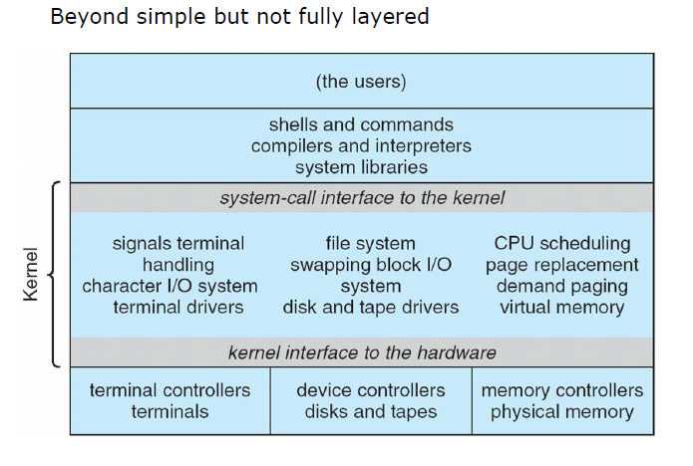
Non Simple Structure -- UNIX

Slide 15
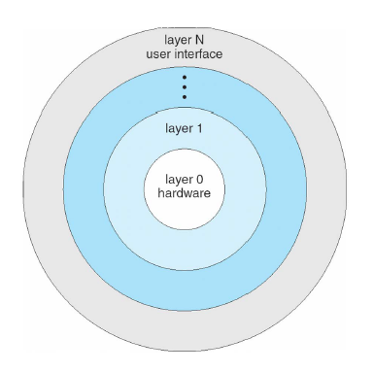
Layered Approach
The operating system is divided into a number of layers (levels), each built on top of lower layers.
The bottom layer (layer 0), is the hardware; the highest (layer N) is the user interface.
Main advantage of layered approach is Modularity.
With modularity, layers are selected such that each uses functions (operations) and services of only lower-level layers.
The major difficulty with layered approach is to divide the layers carefully, because a layer can use only those layers which are below it.

Slide 16
Microkernel System Structure
Moves as much from the kernel into user space
Mach example of microkernel
Mac OS X kernel (Darwin) partly based on Mach
Communication takes place between user modules using message passing
Benefits:
Easier to extend a microkernel
Easier to port the operating system to new architectures
More reliable (less code is running in kernel mode)
More secure
Detriments: Performance overhead of user space to kernel space communication

Slide 17
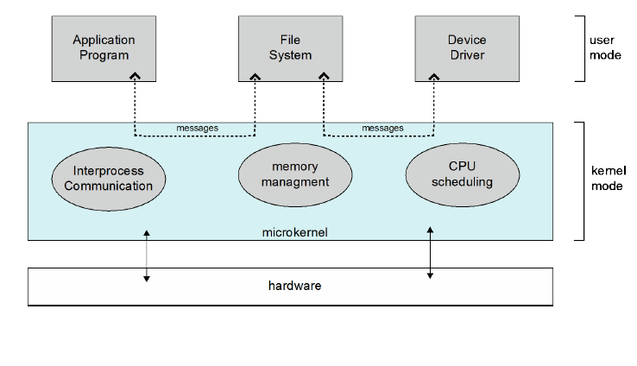
Microkernel System Structure
Kernel is a computer program that manages I/O requests from software and translates them into data processing instructions for CPU and other electronic components of computer.

Slide 18
What is a Kernel?
The kernel is a computer program at the core of a computer's operating system with complete control over everything in the system. It is an integral part of any operating system.
Features of Kernel
Low-level scheduling of processes
Inter-process communication
Process synchronization
Context switching

Slide 19
Shell
What is difference between kernel and shell?
Kernel is the heart and core of an Operating System that manages operations of computer and hardware.…
Difference between Shell and Kernel :
1. Shell allows the users to communicate with the kernel.Kernel controls all the tasks of the system.
2. Shell is the interface between kernel and user. Kernal It is the core of the operating system.

Slide 20
Applications of Operating System
Security
Control over system performance
Job accounting
Error detecting aids
Coordination between other softwares and users

Slide 21
Conclusion
This lecture makes the student familiar with basics of operating systems like OS Definition, need of OS, OS structure, kernel, applications of OS etc.

Slide 22
References
https://www.includehelp.com/c-programming-questions/
https://www.studytonight.com/operating-system/
https://computing.llnl.gov/tutorials/
https://www.tutorialspoint.com/operating_system/index.htm#:~:text=An%20operating%20system%20(OS)%20is,software%20in%20a%20computer%20system.
https://www.javatpoint.com/os-tutorial
https://www.guru99.com/operating-system-tutorial.html
https://www.geeksforgeeks.org/operating-systems/

